Slide 1
Multi class classification on text data

Slide 2
Pre-processing techniques
Stop words removal
Lemmatization
Special characters removal
Punctuation removal
Tokenization(bag of words approach):
MAX_NB_WORDS = 50000
MAX_SEQUENCE_LENGTH = 250
EMBEDDING_DIM = 100

Slide 3
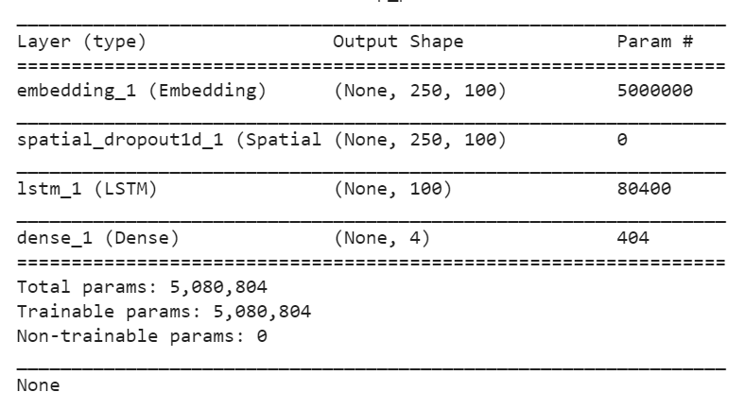
Model
LSTM Autoencoder
Parameters of layers
Loss type: categorical_crossentropy

Slide 4
Training parameters
epochs = 10
batch_size = 64
Test_set = 20% of total dataset
Validation_set = 0.1% of training dataset

Slide 5
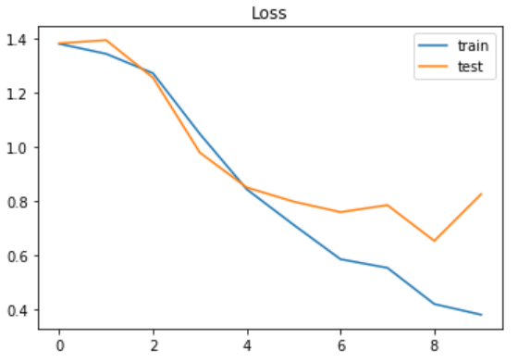
Accuracy metrics
loss: 0.3799 - acc: 0.9359 - val_loss: 0.8247 - val_acc: 0.7353
Test set Loss: 0.867 Accuracy: 0.747(without punctuation removal)
loss: 0.3622 - acc: 0.9095 - val_loss: 0.7386 - val_acc: 0.7647
Test set Loss: 0.701 Accuracy: 0.759

